Slide 1
Ironhack | Data Analytics | Project 4 | Silvia Nicolau
Recipe for Eternity

Slide 2

Who wants to live forever?

Slide 3
Recipe for Eternity
How to live forever?
Analysis of the influence
of some nutrition factors
in diseases related to nutrition

Slide 4



Data & Metrics
Nutrition
Domestic supply quantity in European countries over the years
All sugar forms
Sweetners, honey, dates
Fruits & veggies
Diseases
Causes of death in European countries over the years
Diabetes
Malnutrition
Cancers of the digestive system (oral, oesophagus, stomach, colon)

Slide 5

Data & Metrics
Population
Total population in European countries over the years
(to normalize the previous data)
Body Mass Index
BMI in European countries over the years

Slide 6
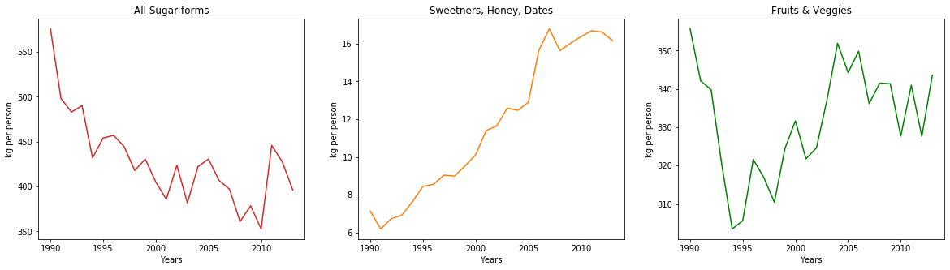
Results - Nutrition
Sugar consumption is decreasing
Sugar alternatives are increasing
Fruits & Veggies are increasing but are still less consumed than sugar!
Notes:
The tendencies seem different and the statistic tests show they are actually different

Slide 7
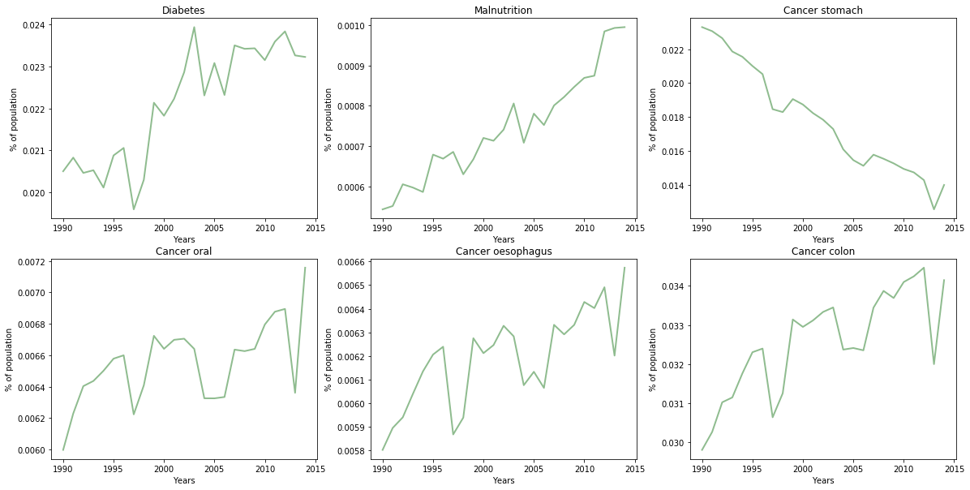
Results - Diseases
Notes:
Explicar a Malnutrition

Slide 8
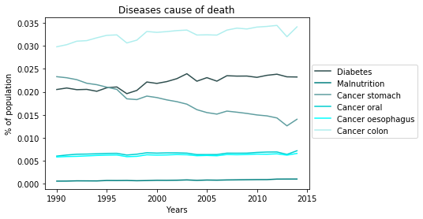
Results - Diseases
Stomach cancer is the only one decreasing
Colon cancer is the deadliest (after lung cancer*) and also the most prevalent (after breast and prostate*)
* Data from ourworldindata.org/cancer

Slide 9
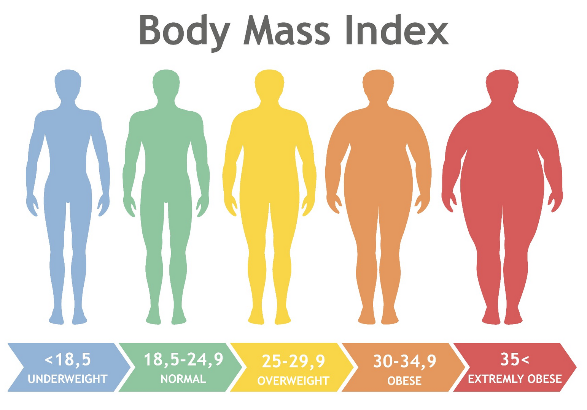
Results - BMI

Slide 10
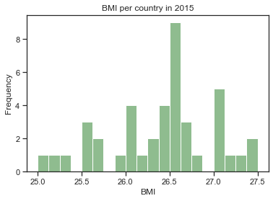
Results - BMI - by Country
BMI seems to have a Normal distribution among the European countries and statistics do not deny that
Infer to other developed countries
(with 95% confidence):
25.2 < BMI < 27.6 (overweight)

Slide 11
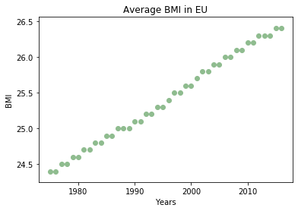
Results - BMI - average in Europe
There is an evident liner relation

Slide 12
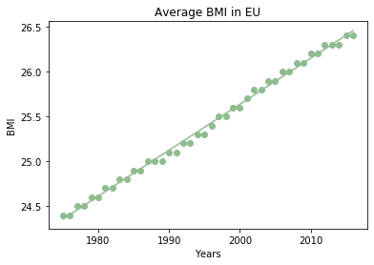
Results - BMI - average in Europe
There is an evident liner relation
Which is statisticaly proven

Slide 13
Results - BMI - average in Europe
There is an evident liner relation
Which is statisticaly proven
Predict when BMI=30 (obese):
by 2080!

Slide 14
Results - Relations
Sugar vs Diabetes
Sugar consumption is decreasing and Diabetes is increasing so it needs further investigation of risk factors (other than nutrition)
BMI vs Colon cancer
Statistics shows that they are highly related so weight control is recommended
Notes:
Explicar a selecção das foods
The tendencies seem different and the statistic tests show they are actually different

Slide 15
Recipe for Eternity
How to live forever?
Who wants to live forever?

Slide 16

Recipe for Eternity
How to live forever?
Who wants to live forever?

